Slide 1
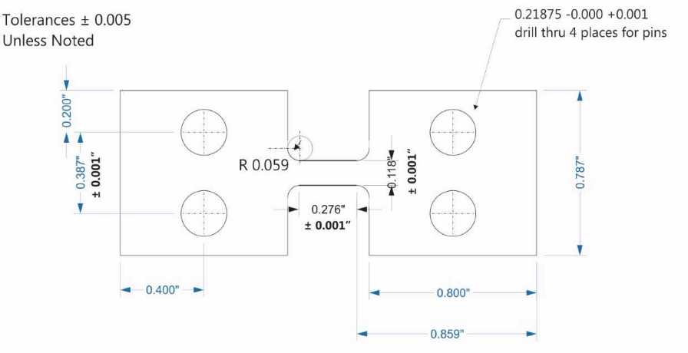
NIST SURF Inconel 625 Analysis 1
A Study of Inconel 625 in both Tension and Compression at High Strain Rates using a Pulse-Heated Split Hopkinson Bar
Author: Charlie Nitschelm
Mentor: Steven Mates

Slide 2
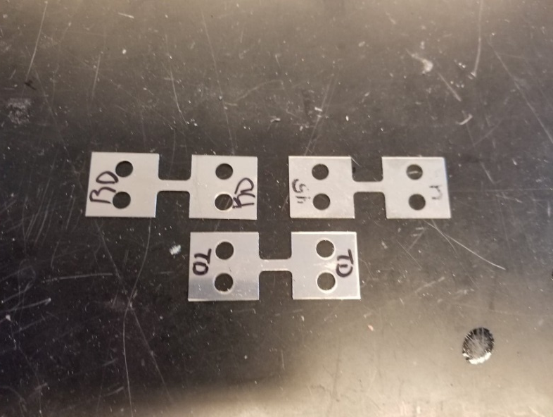
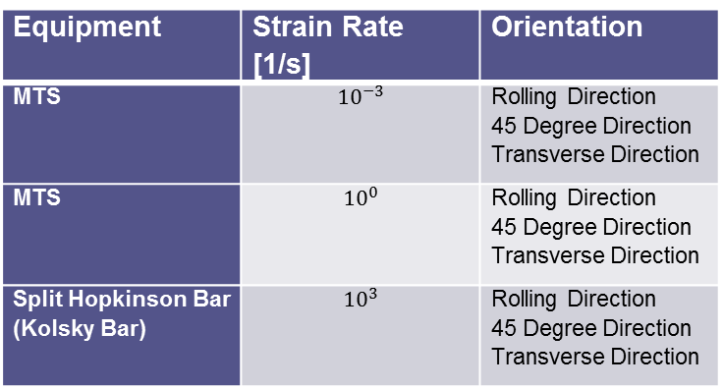
Inconel 625 Tension Specimens for Tension Tests
To probe the necking and fracture mechanics of Inconel 625 to derive the parameters of the Johnson-Cook equation to better design systems using the material.
Equipment | Strain Rate [1/s] | Orientation
MTS | $${10}^{−3}$$ | Rolling Direction 45 Degree Direction Transverse Direction
MTS | $${10}^{0}$$ | Rolling Direction 45 Degree Direction Transverse Direction
Split Hopkinson Bar (Kolsky Bar) | $${10}^{3}$$ | Rolling Direction 45 Degree Direction Transverse Direction
Inconel sheets come with a specific direction of rolling to form it to its given dimensions. To understand the mechanical difference, different orientations of the Inconel 625 must be tested at various strain rates.

Slide 3
Pertinent Information
The Slow for NIST is at a strain rate of ~ 1 * 10^-4/s
The Slow for UNH is at a strain rate of ~ 1 * 10^-3/s
The Medium for NIST is at a strain rate of ~ 0.1/s
The Fast for NIST is at a strain rate of ~ 10^3/s
The NIST Slow and Medium tests were measured using the MTS load displacement data and DIC.
The NIST Kolsky tests were measured with strain gages and DIC.
All tests are tensile at various strain rates.

Slide 4
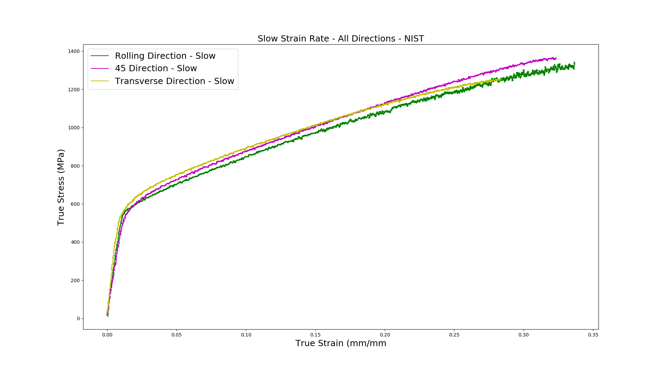
NIST Slow Tests

Slide 5
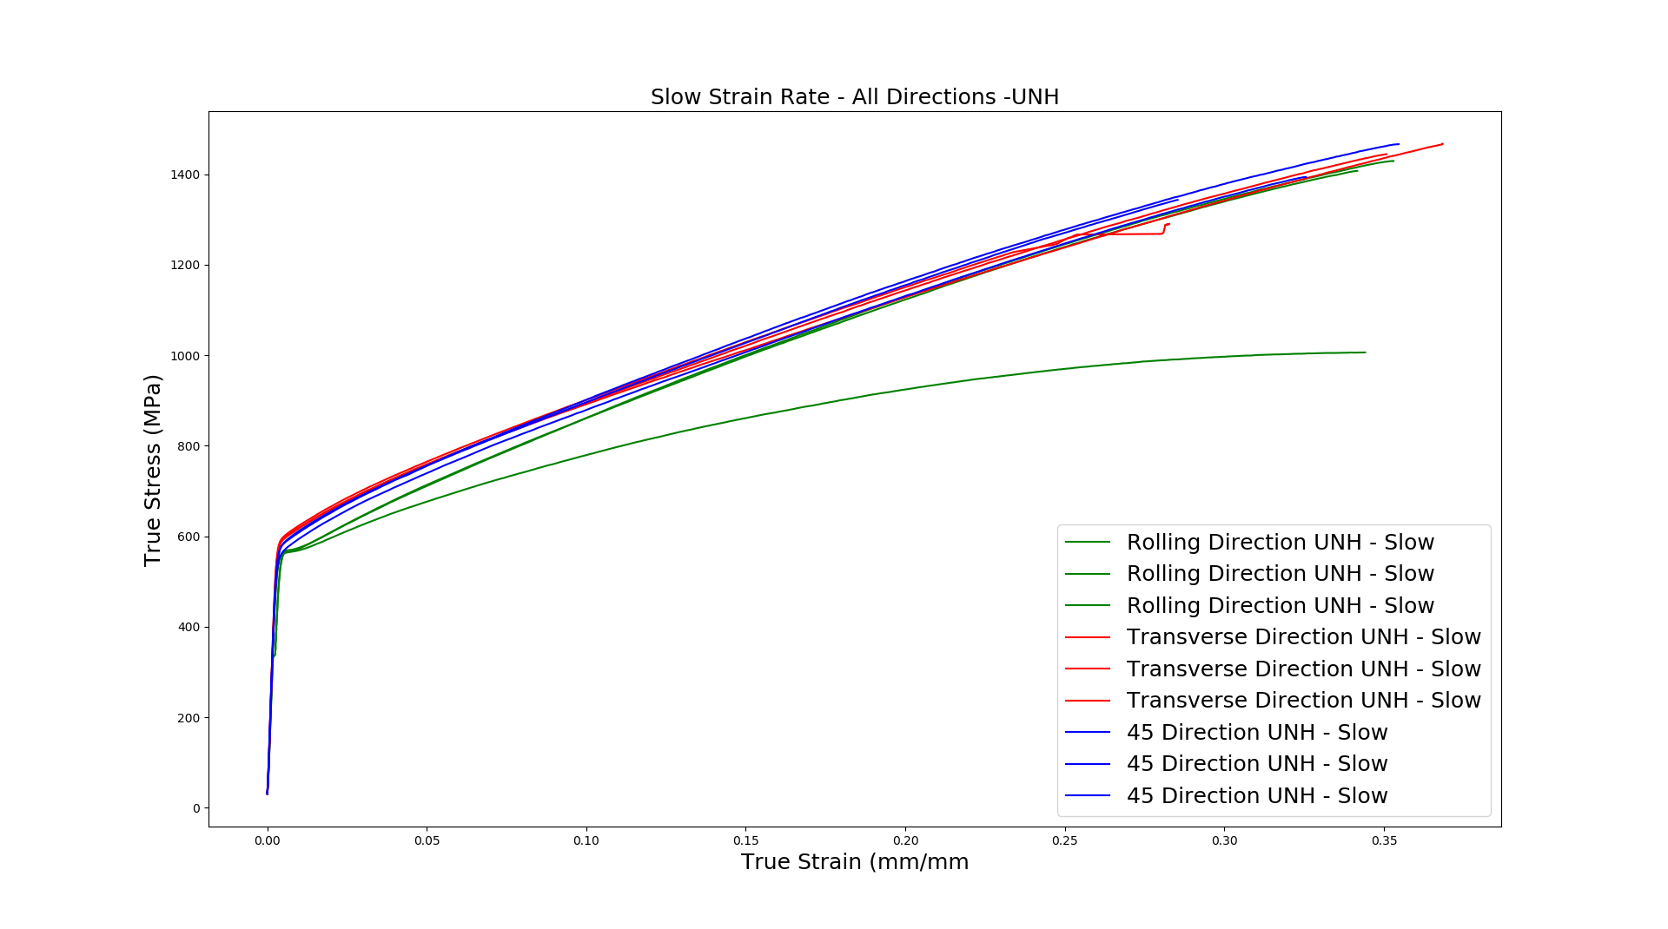
UNH Slow Tests

Slide 6
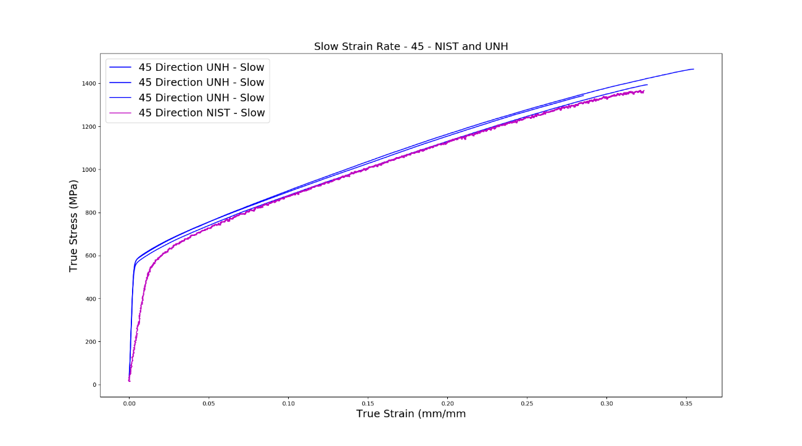
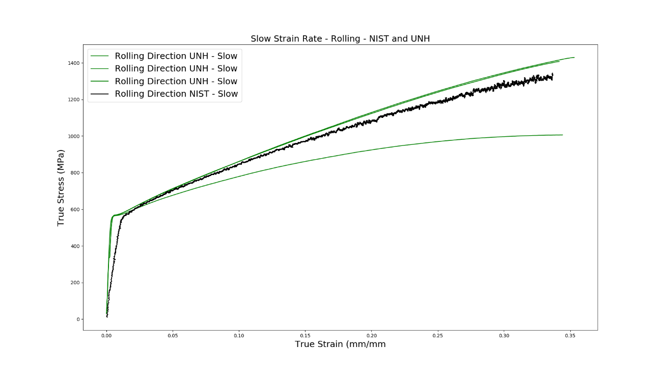
NIST and UNH Slow Tests
It seems the yield point for our tests are measuring different values.
Could be from the analysis on my end… Steve and I can take a look when he gets back next week
The RD Outlier from UNH spawns from the raw data in Excel. RD-2 seems to be the issue….

Slide 7
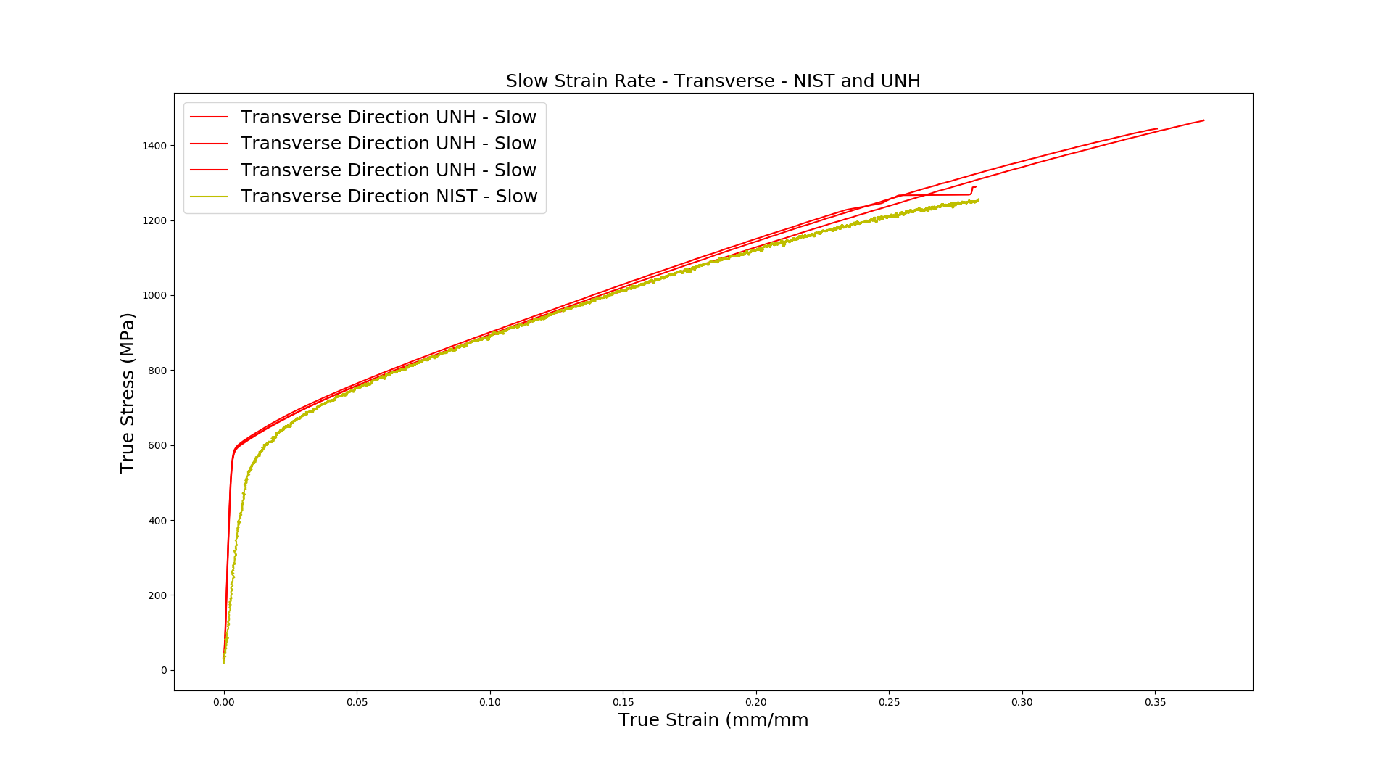
NIST and UNH Slow Tests
Same here
It appears that the plastic deformation for our tests are fairly close to one another, in general

Slide 8
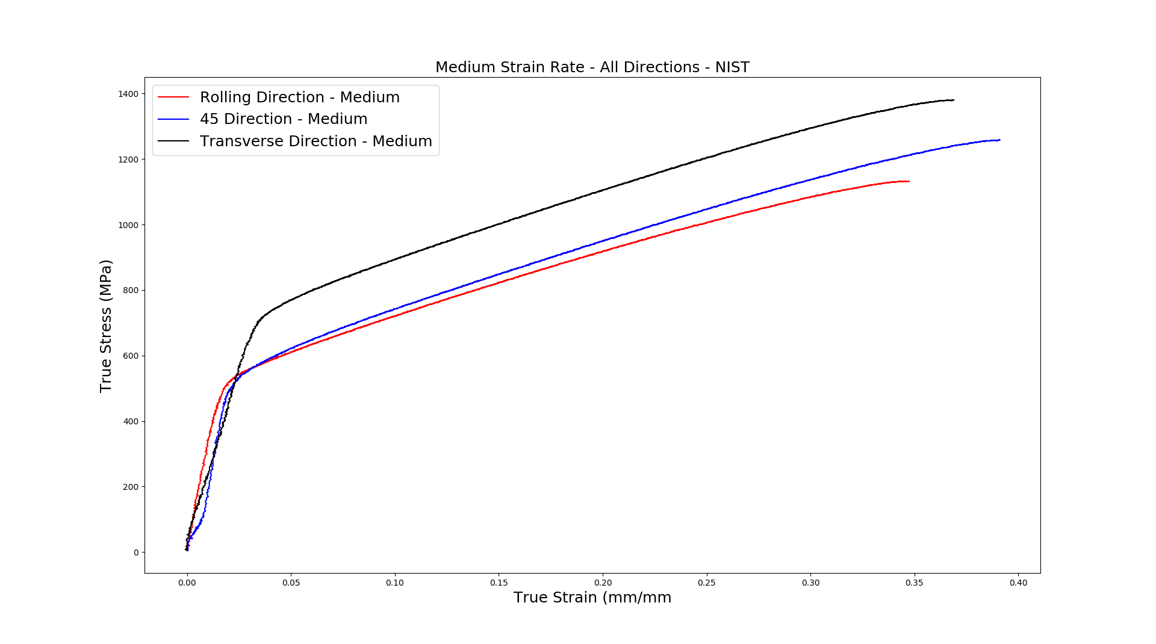
Medium Strain Rate at NIST

Slide 9
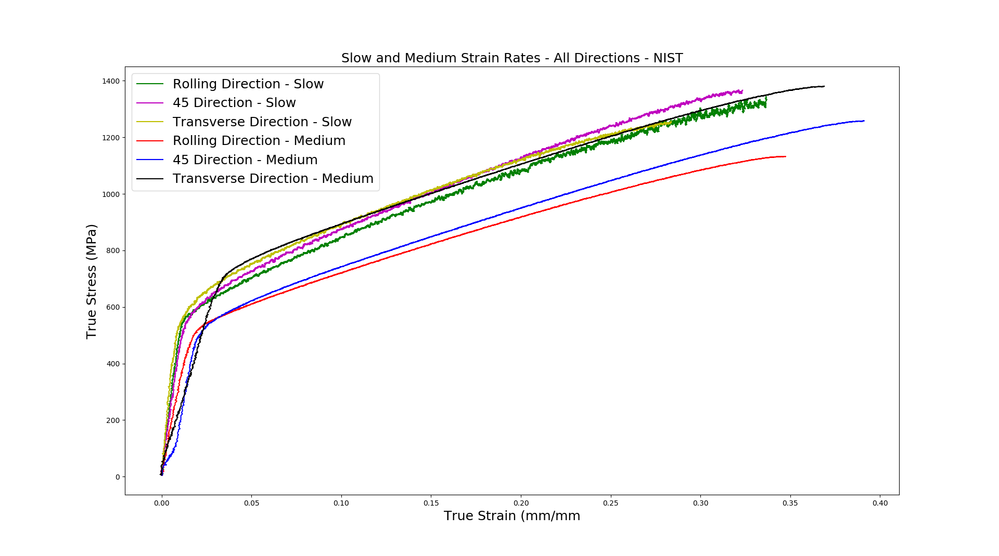
Slow and Medium Strain Rates – All - NIST

Slide 10
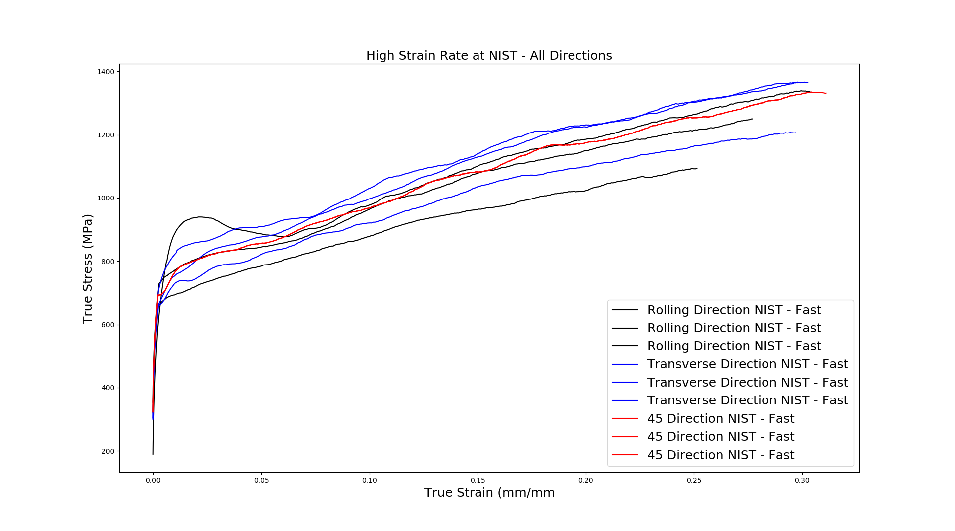
NIST Fast Strain Rate
This hump is an outlier to the data and should not be considered.

Slide 11
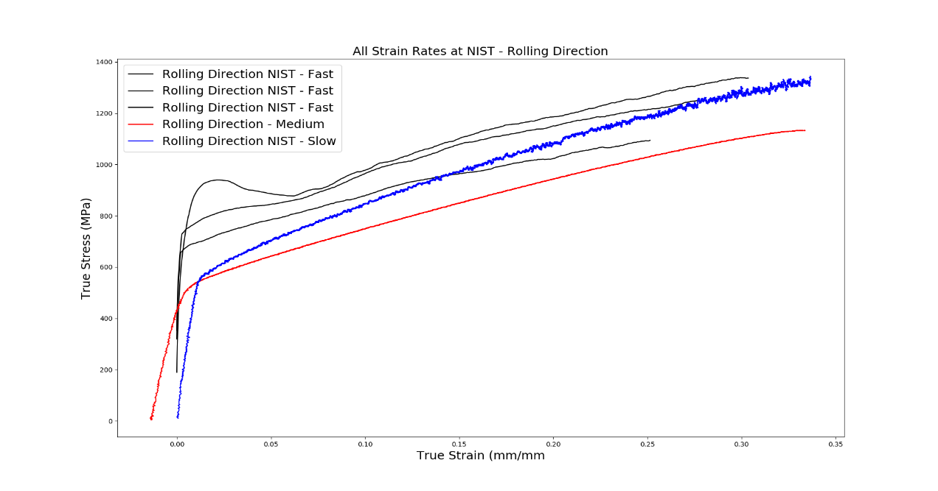
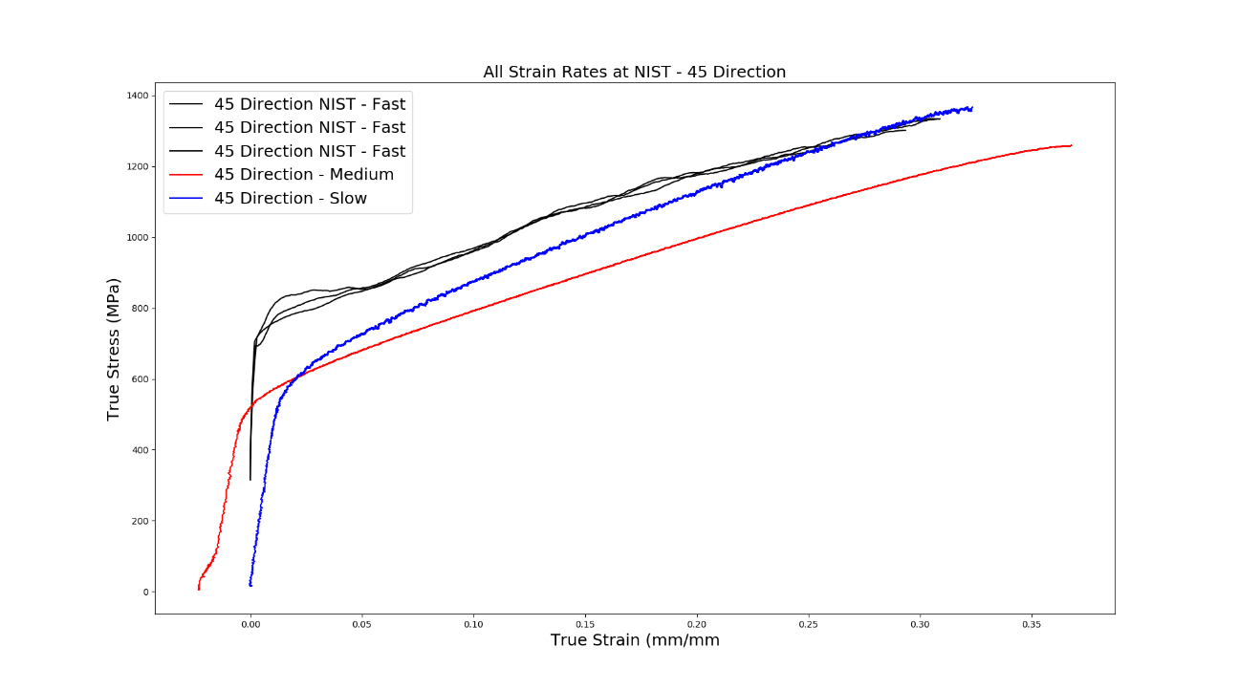
NIST All Strain Rates – All Directions

Slide 12
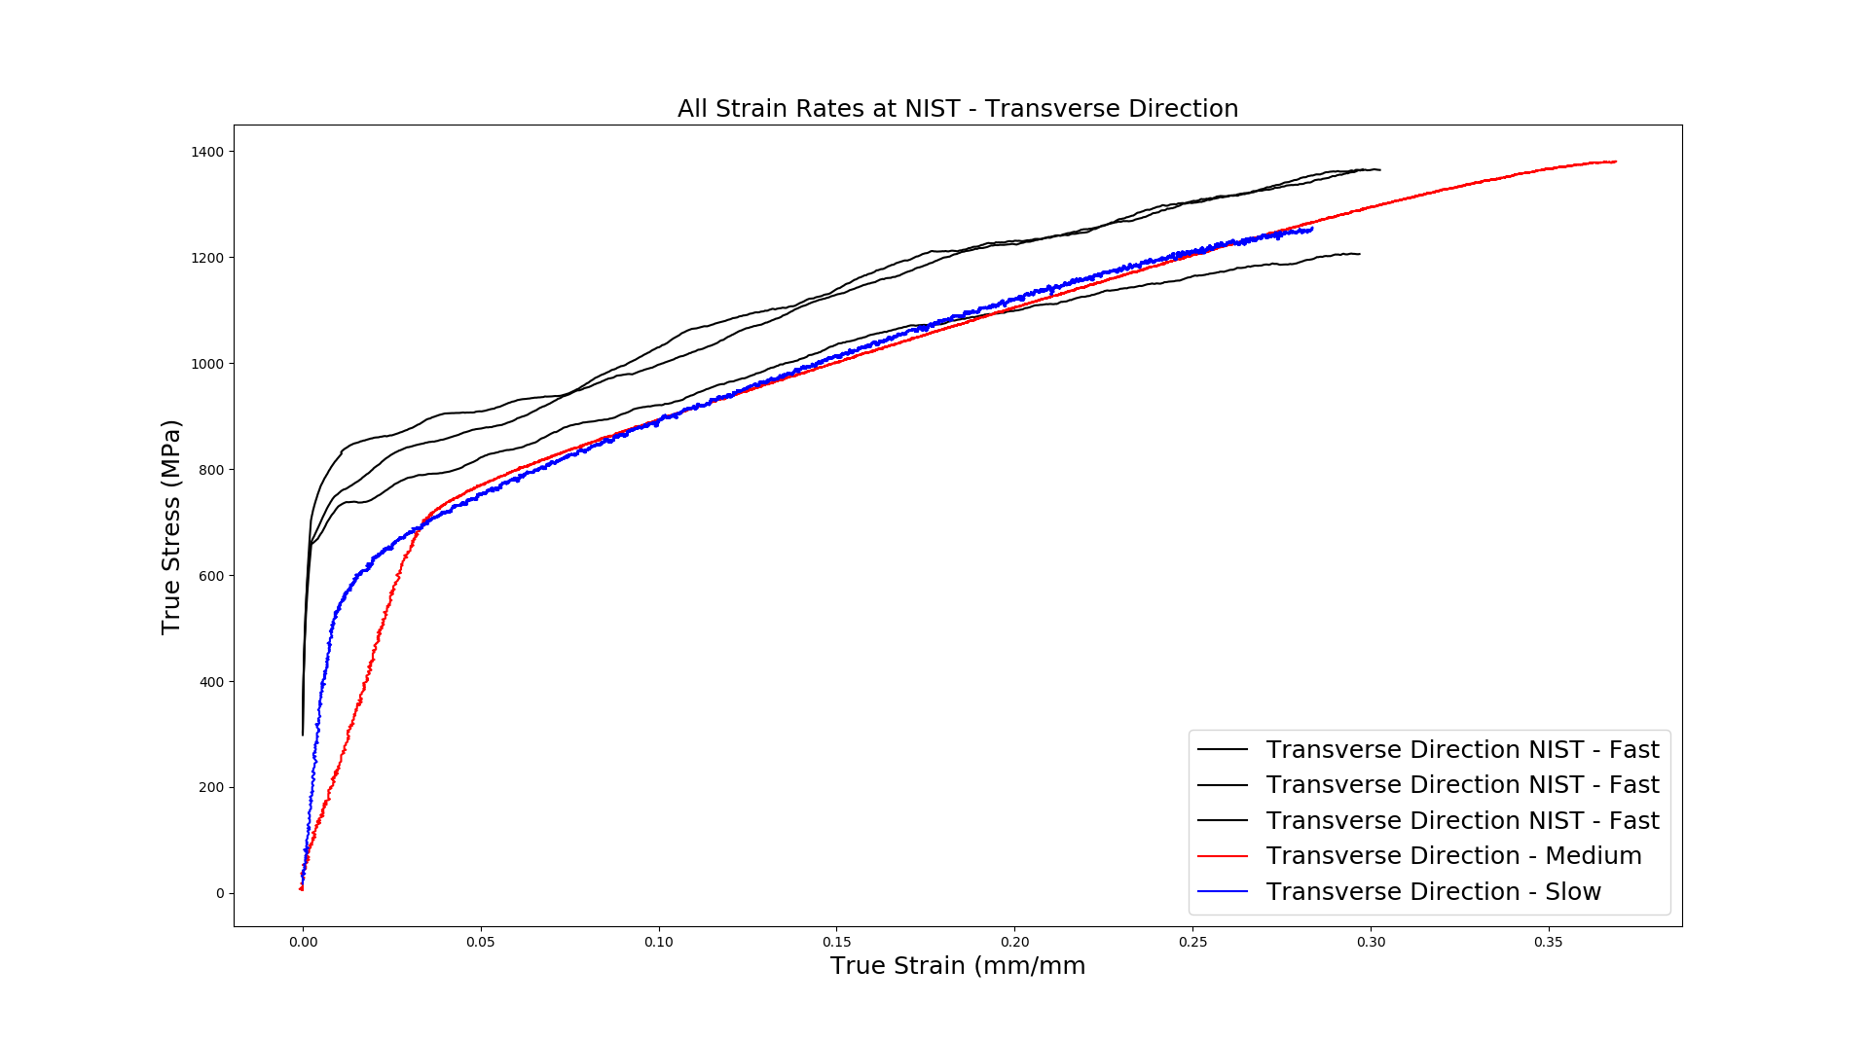
NIST All Strain Rates – Transverse Direction
For the Medium strain rates, we see a higher ductility in the 45 and Transverse directions against the other strain rates.
It seems that the lowest TD high strain rate is an outlier and should not be considered for future analysis

Slide 13
Conclusions and Questions
There is some data analysis that needs to be cleaned up and fixed this upcoming week to bring out data sets closer together. There are errors scattered about with our analysis that needs Steve’s eyes to be fixed.
There are many conclusions that can be made regarding rolling direction, strain rate, etc, that relate to ductility, YS, TS and UTS.
I am currently working on the UTS of all the tests and to format the data in a pleasing visual representation.

